Slide 1



Improving efficiency for Deep Networks
August 24th, 2019
Indian Institute of Science, Bangalore
Akshay Bahadur

Slide 2

Acknowledgement

Slide 3



Akshay Bahadur
SDE – Symantec
Intel Software Innovator
Google Developer Expert
(Machine Learning)

Slide 4
Agenda
Normalization
Optimizers
Activation
Advanced Activation
Focal Loss instead categorical loss
Learning Rate Decay with Adam
Network Architecture optimization
Autopilot research paper by NVIDIA
Handling out of memory issue
Scaling Images
Adding filters and Splitting channels
Fit Generator
DeepSign

Slide 5
Tania’s Story

Slide 6
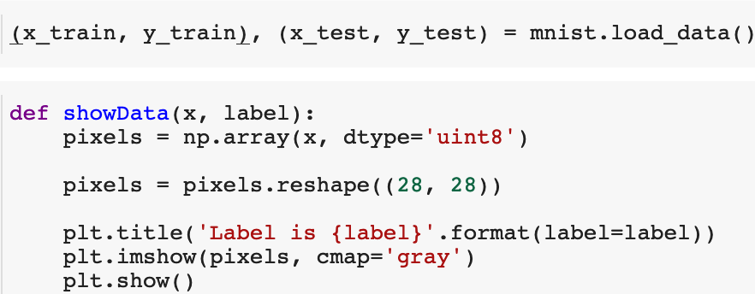
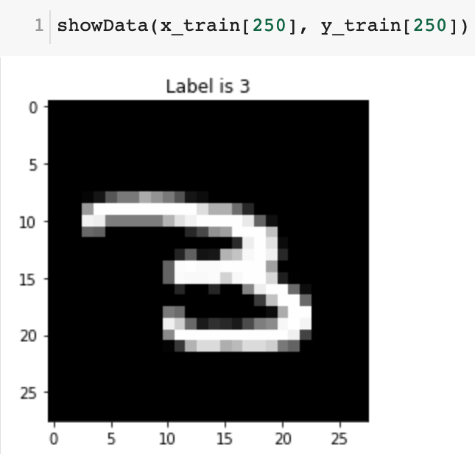
Normalization
Normalization is a technique often applied as part of data preparation for machine learning. The goal of normalization is to change the values of numeric columns in the dataset to a common scale, without distorting differences in the ranges of values.

Slide 7
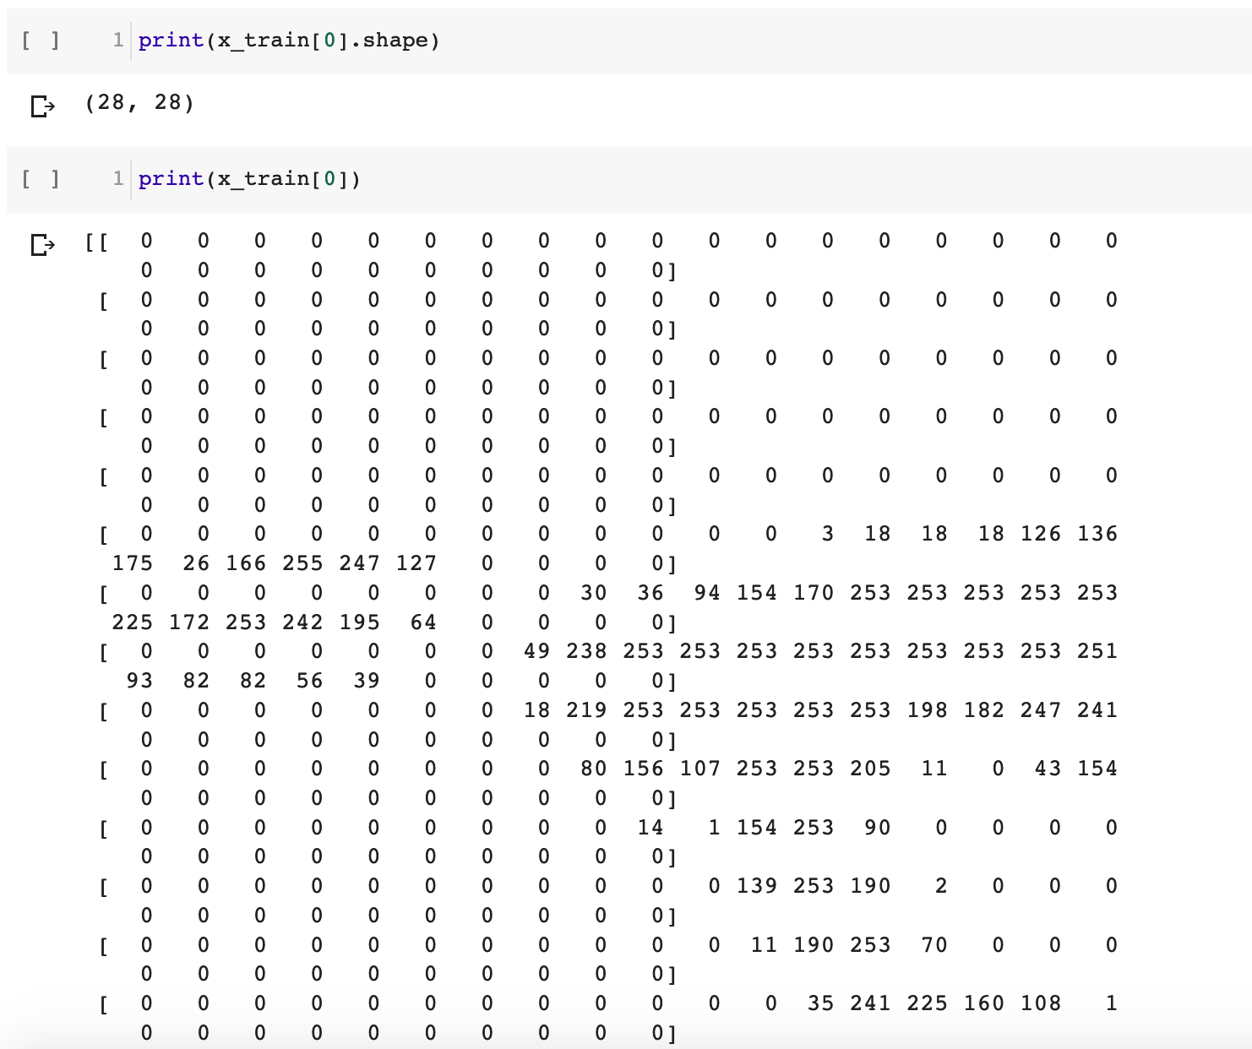

Slide 8
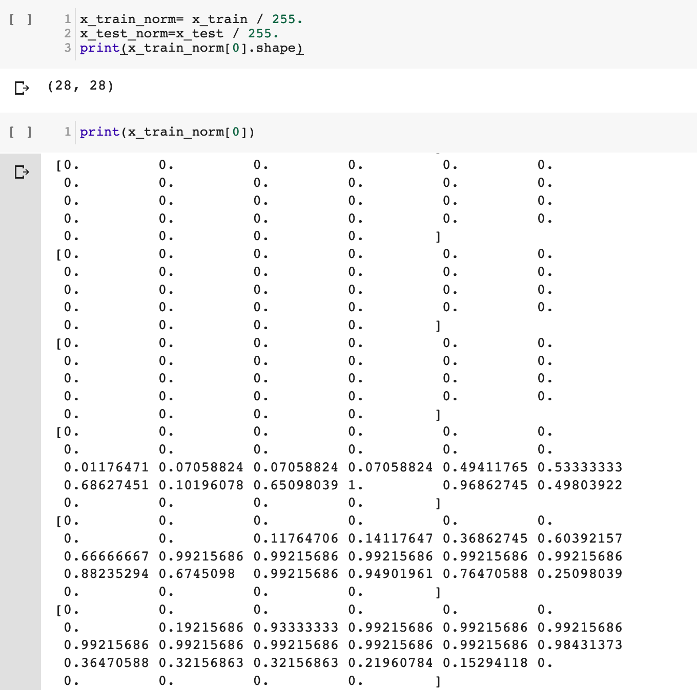

Slide 9
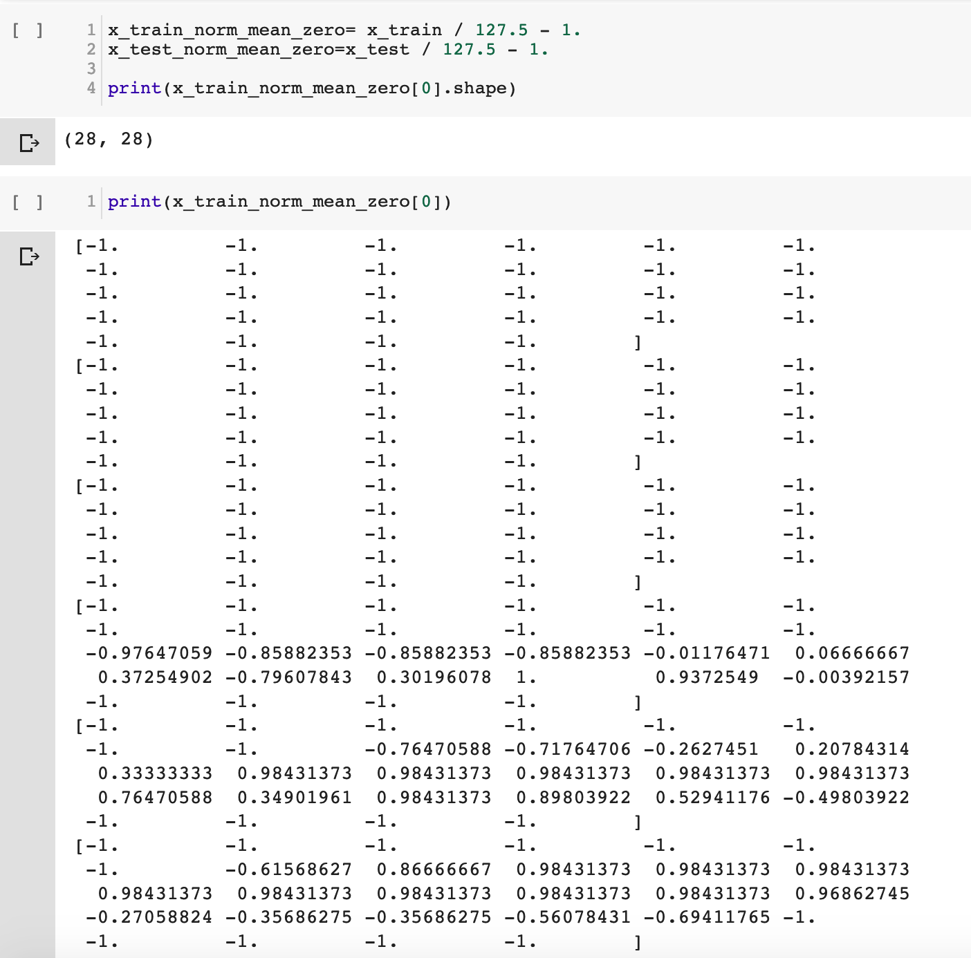

Slide 10
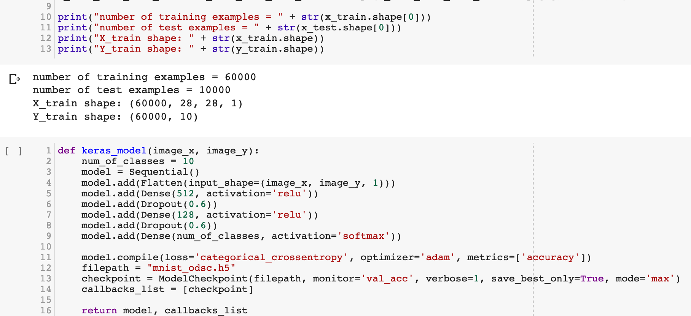

Slide 11
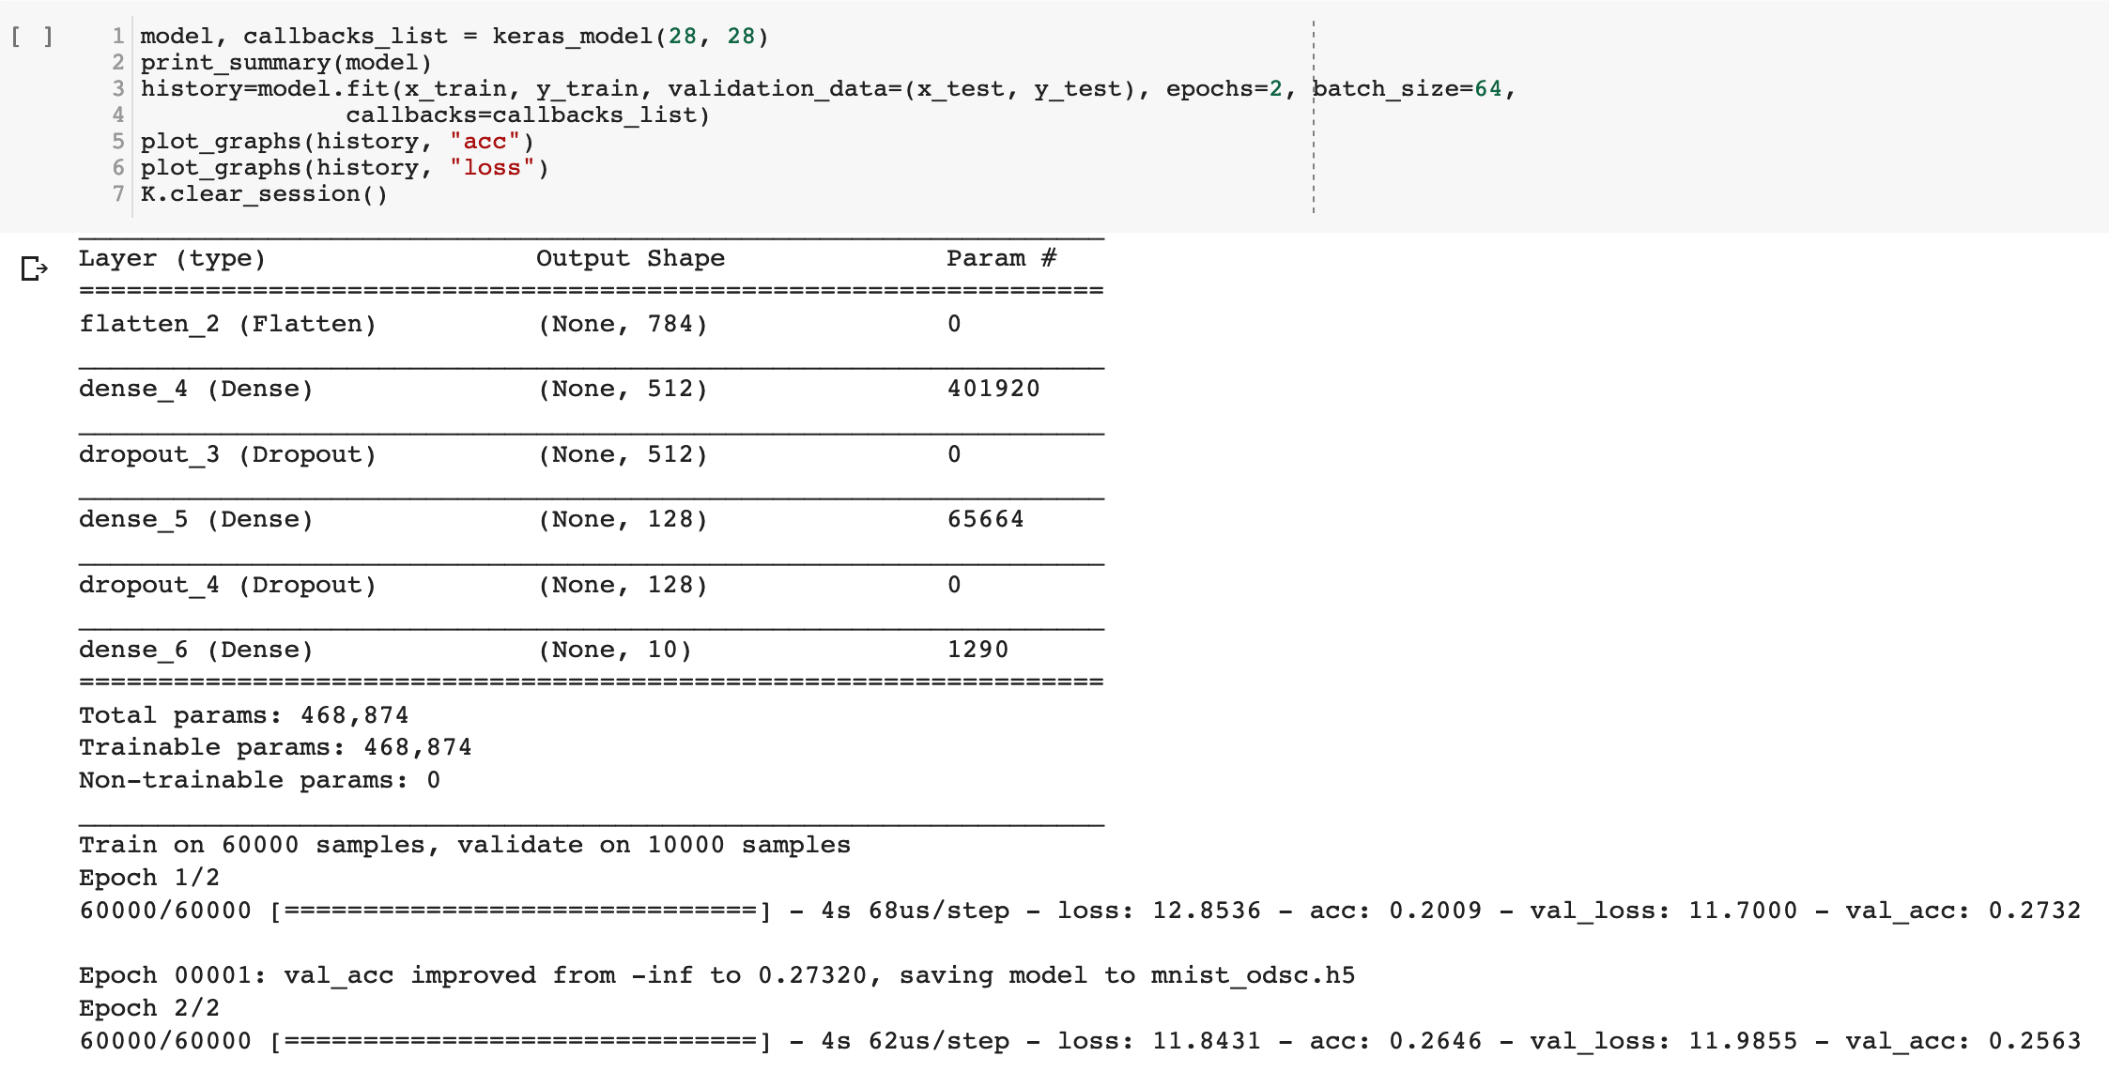

Slide 12
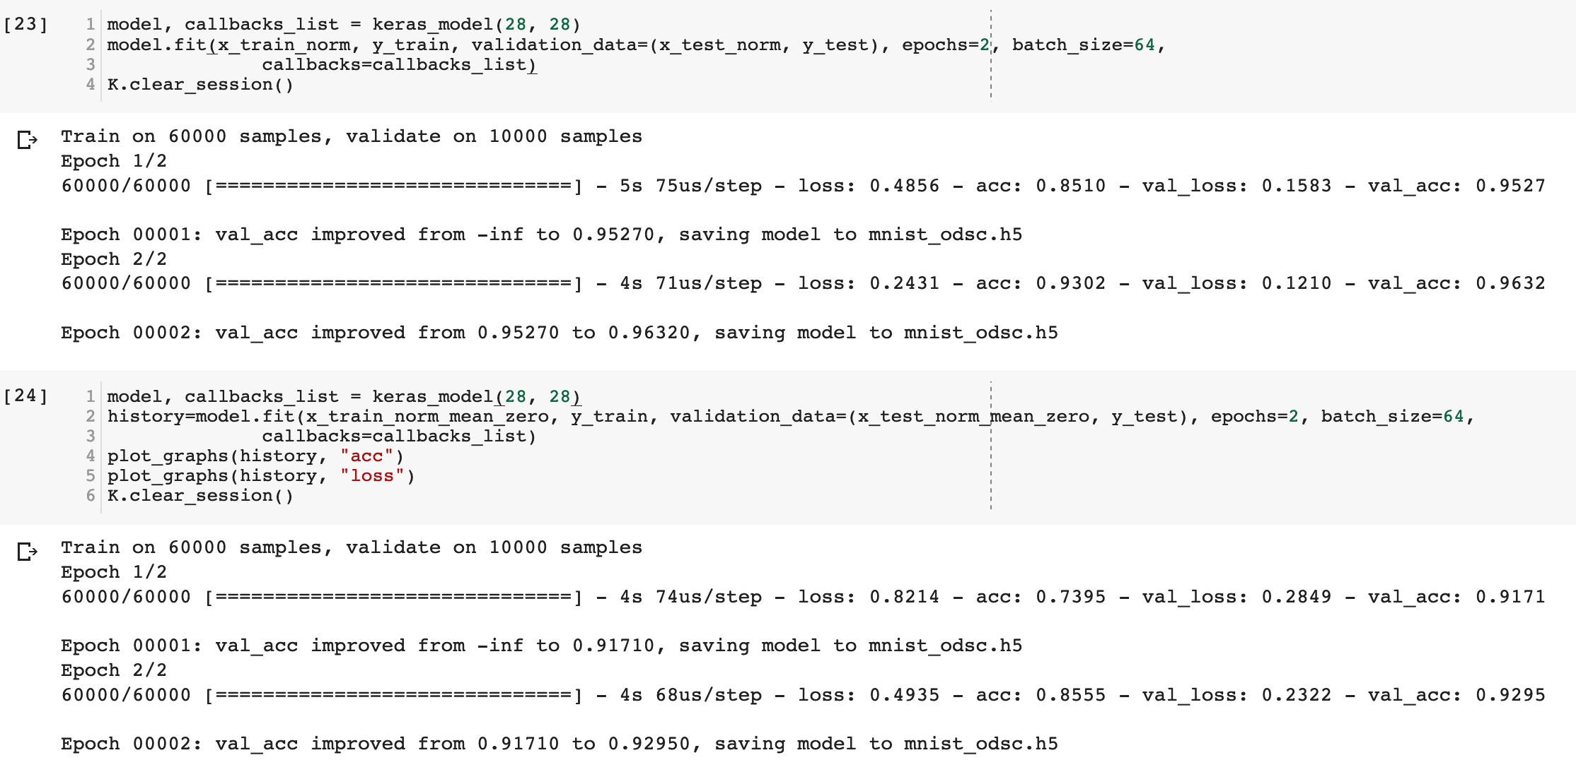

Slide 13
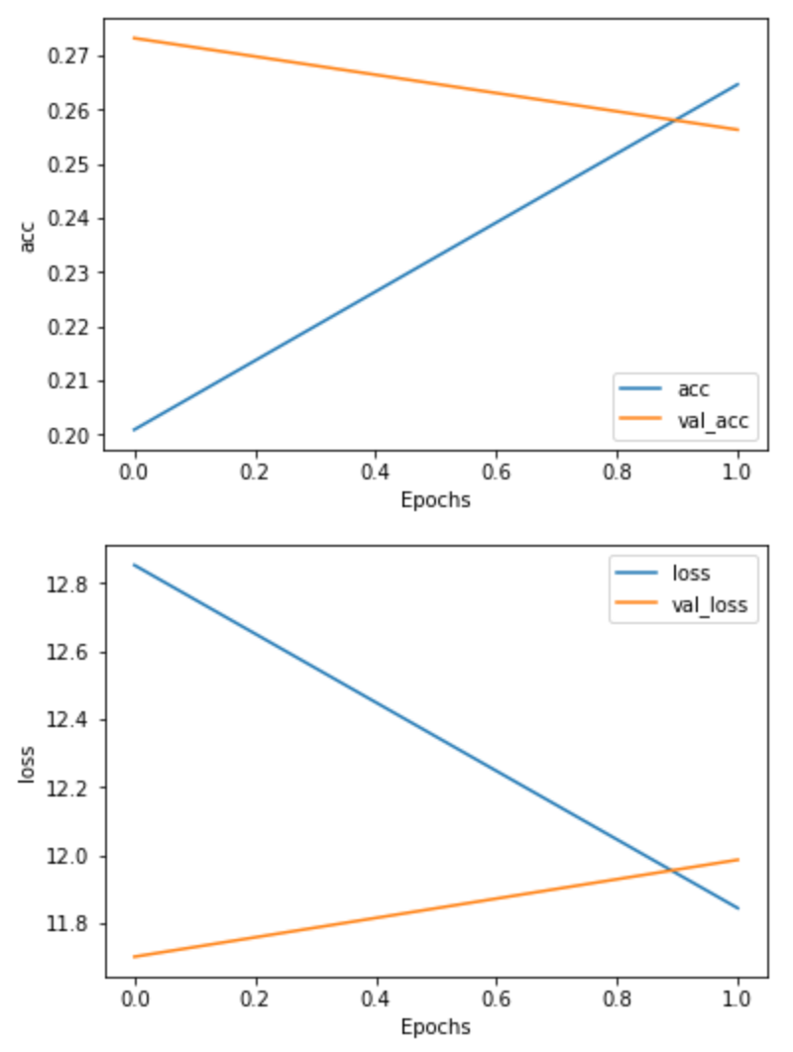
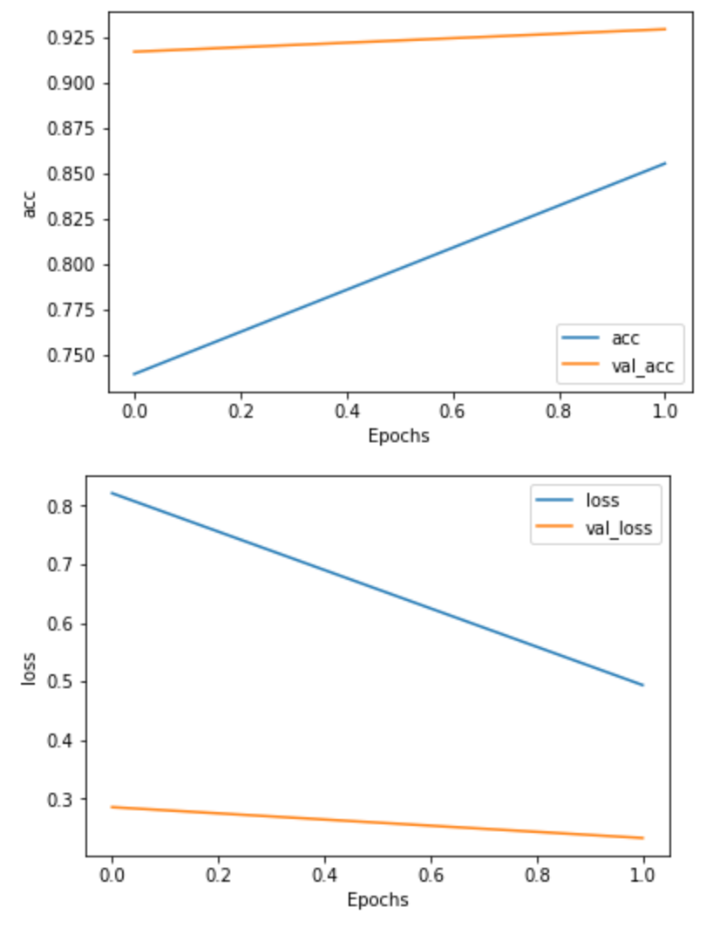

Slide 14
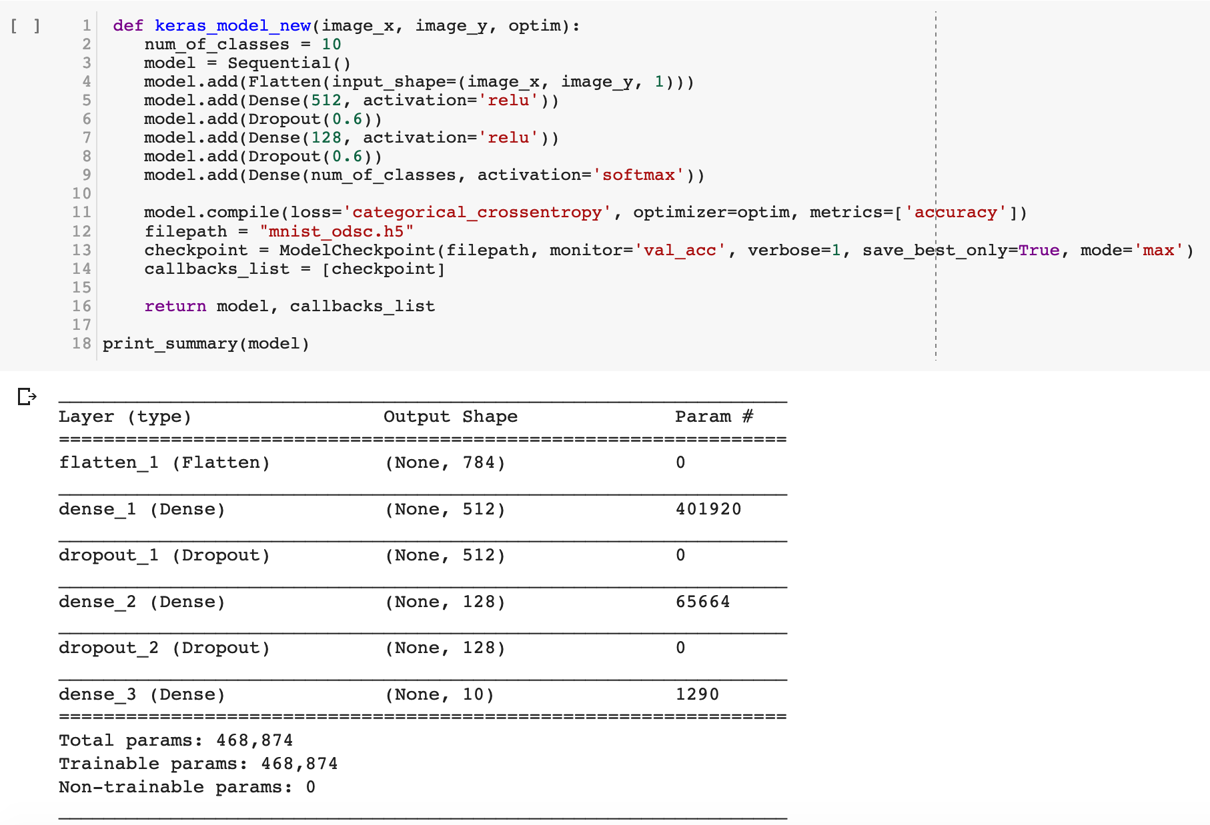
Optimizers

Slide 15
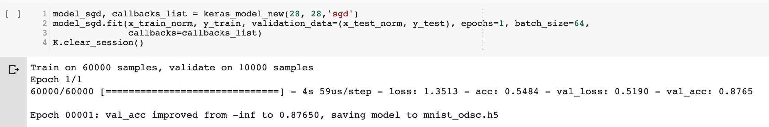
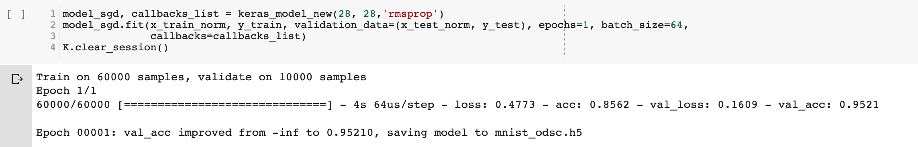
Stochastic Gradient Descent
RMSprop
Notes:
RMSprop

Slide 16
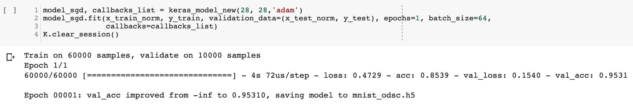
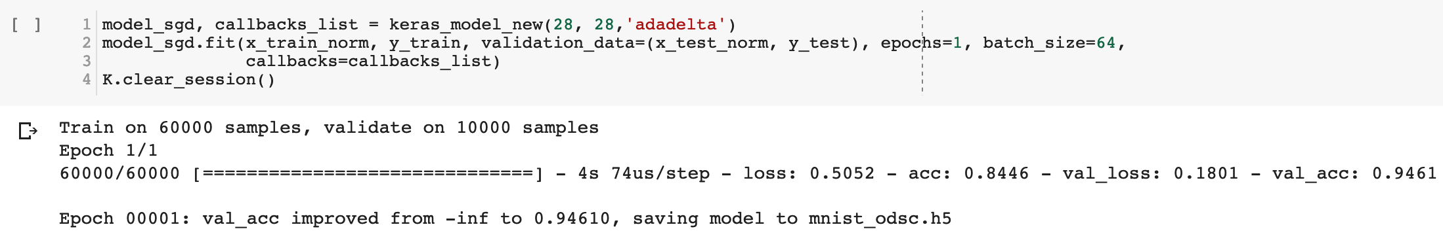
ADAM
AdaDelta
Notes:
RMSprop

Slide 17
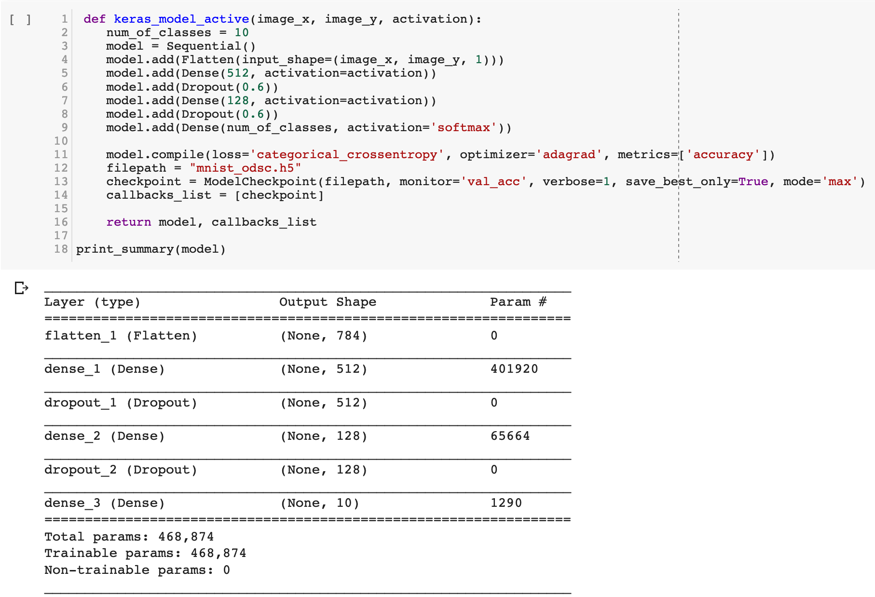
Activation

Slide 18
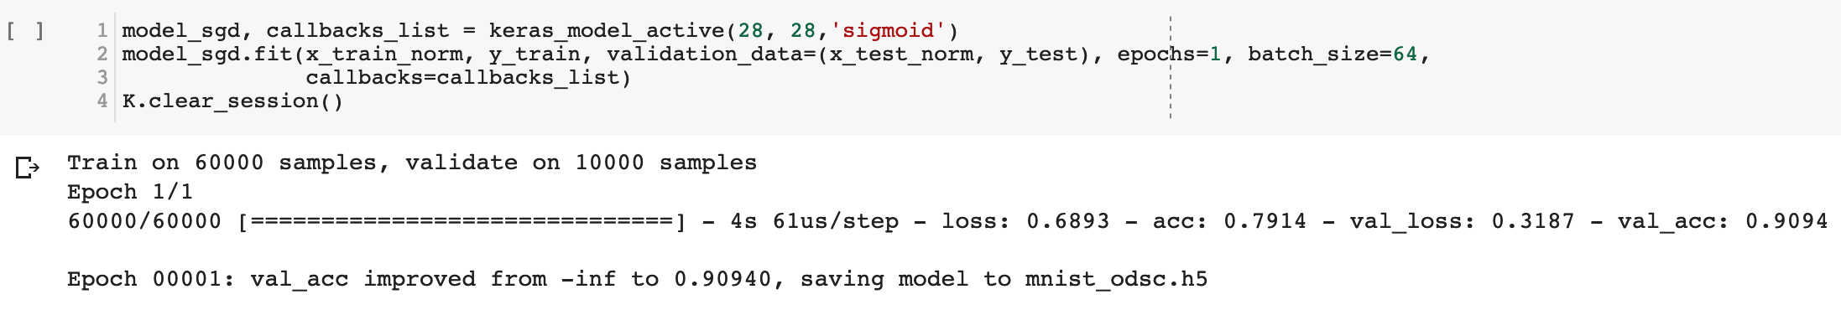
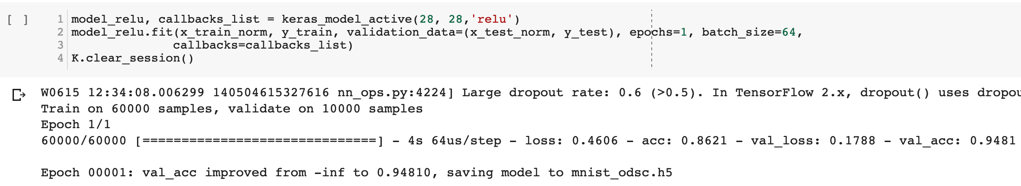
Sigmoid
Rectified Linear Unit
Notes:
RMSprop

Slide 19
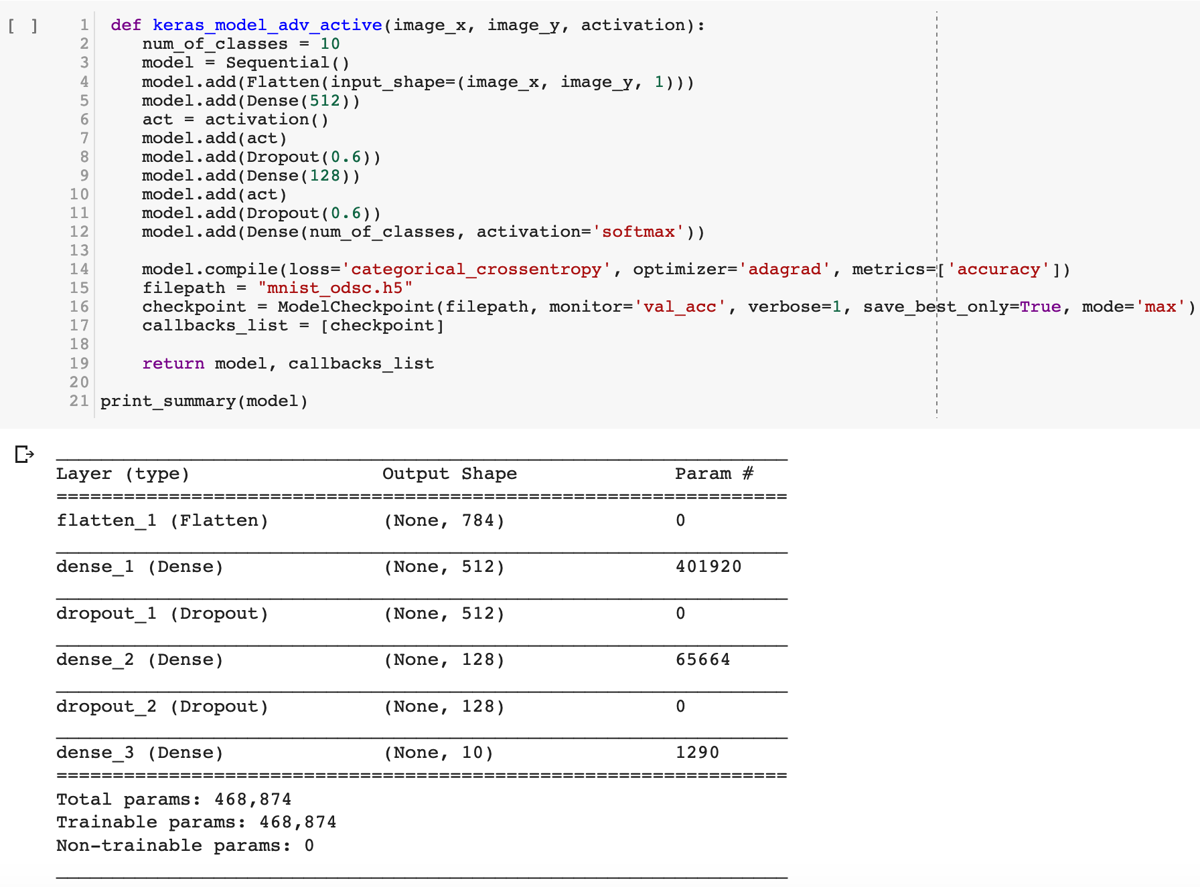
Advanced Activation

Slide 20
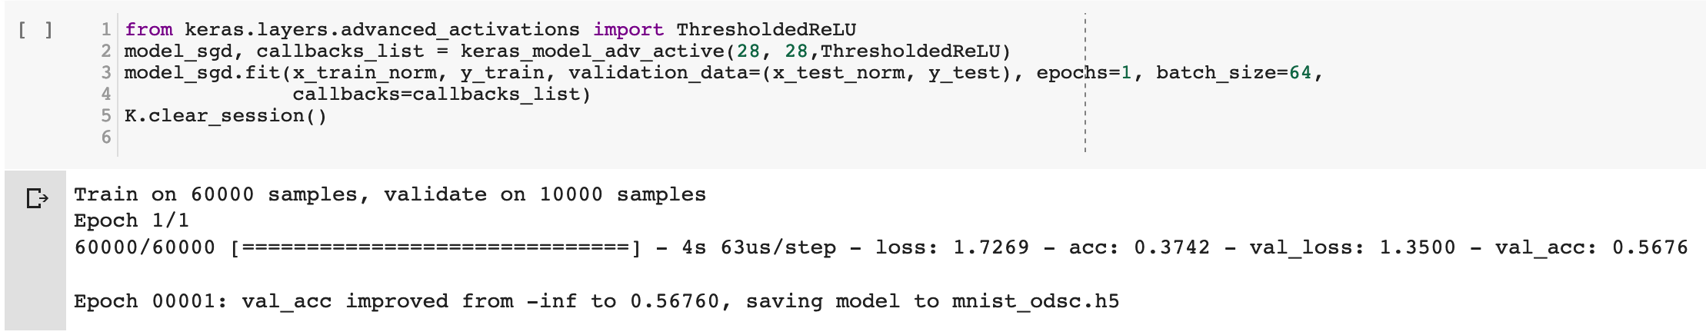
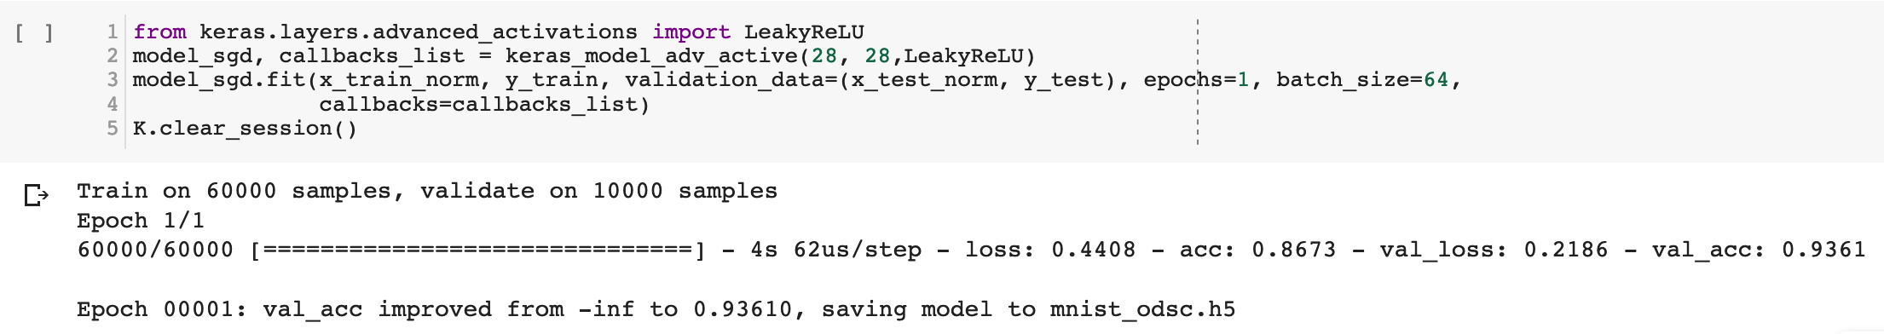
Thresholded ReLU
Leaky ReLU
Notes:
RMSprop

Slide 21
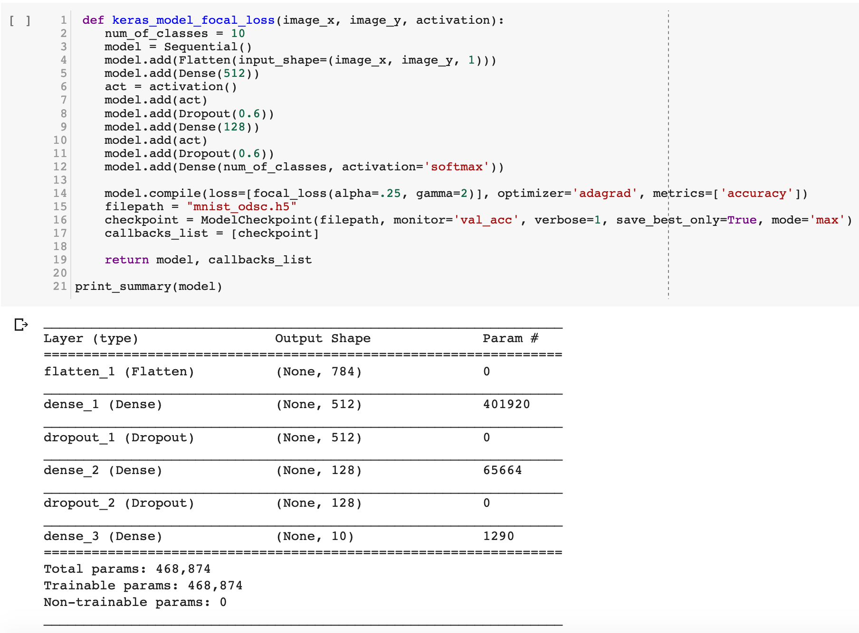
Focal Loss instead of categorical loss

Slide 22
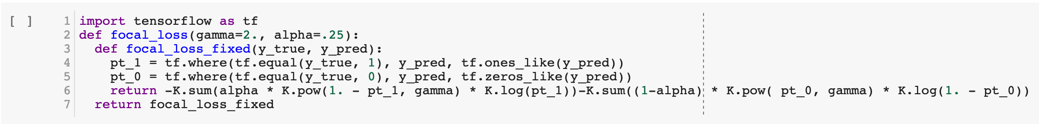
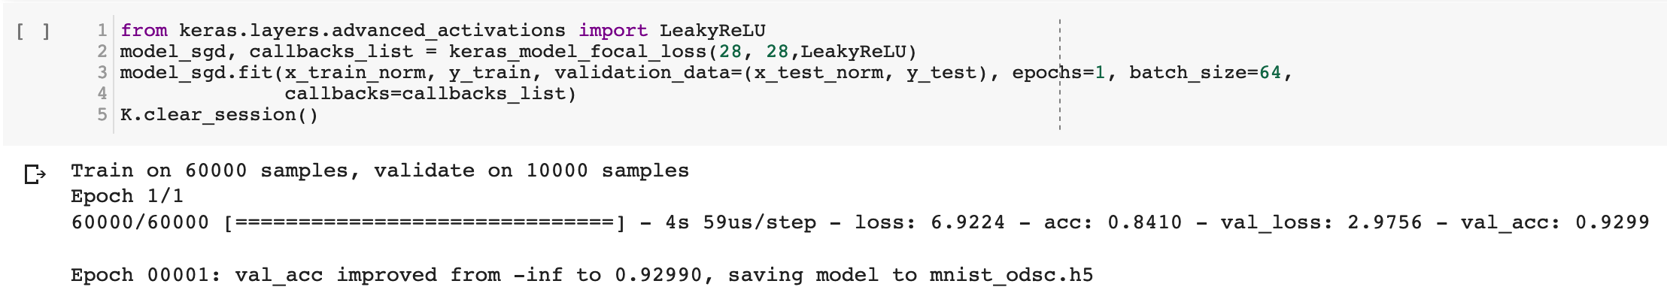
Focal Loss
Notes:
RMSprop

Slide 23
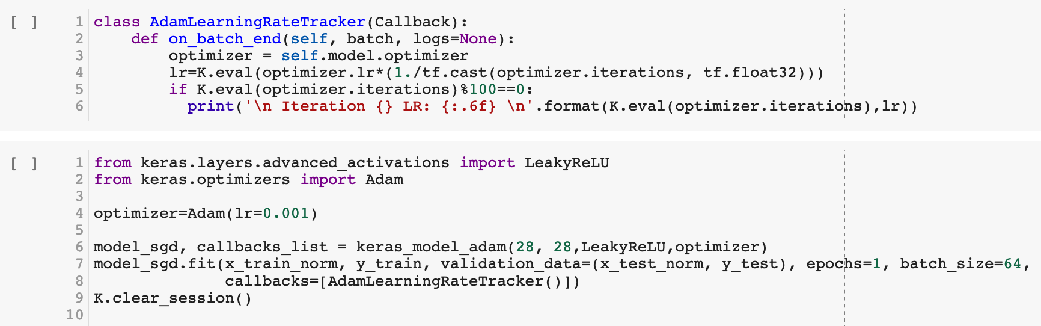
Learning Rate Decay with Adam

Slide 24
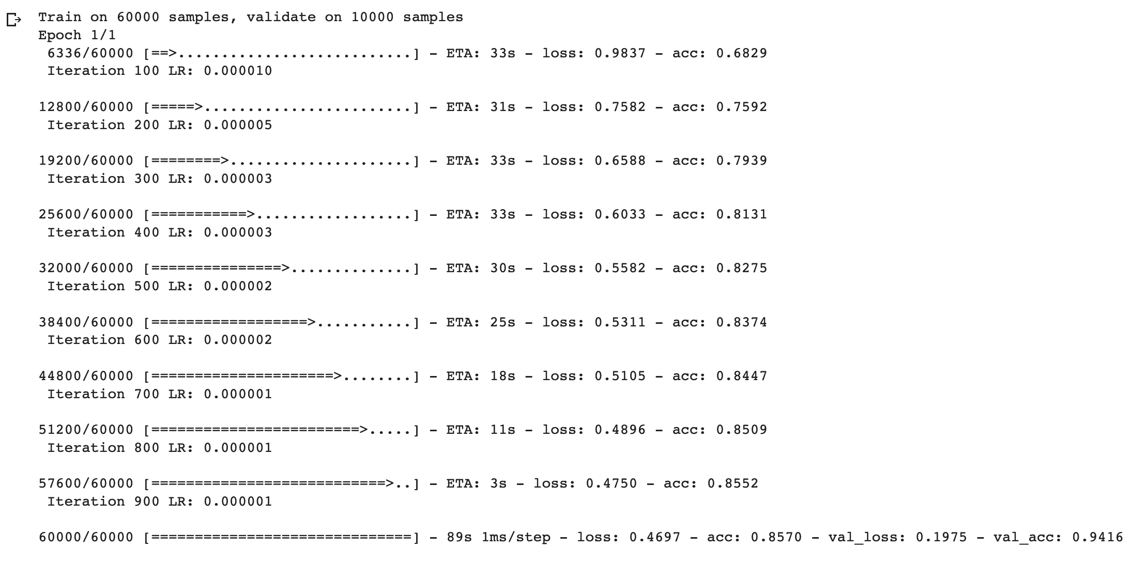

Slide 25
EMNIST

Slide 26
DigiEncoder

Slide 27
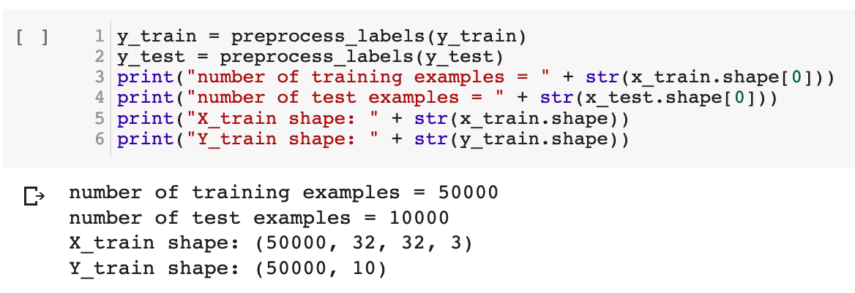
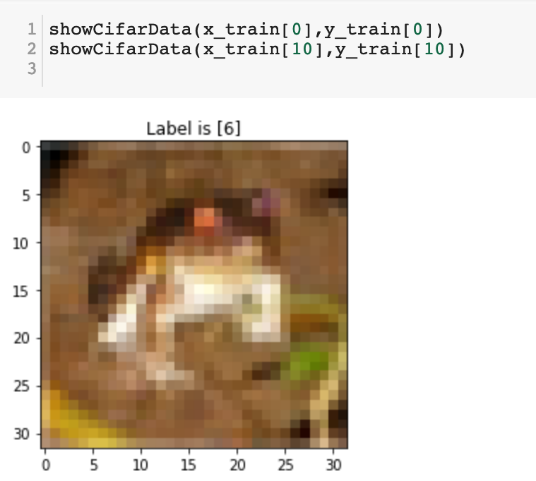
Network Architecture Optimization
Cifar 10

Slide 28
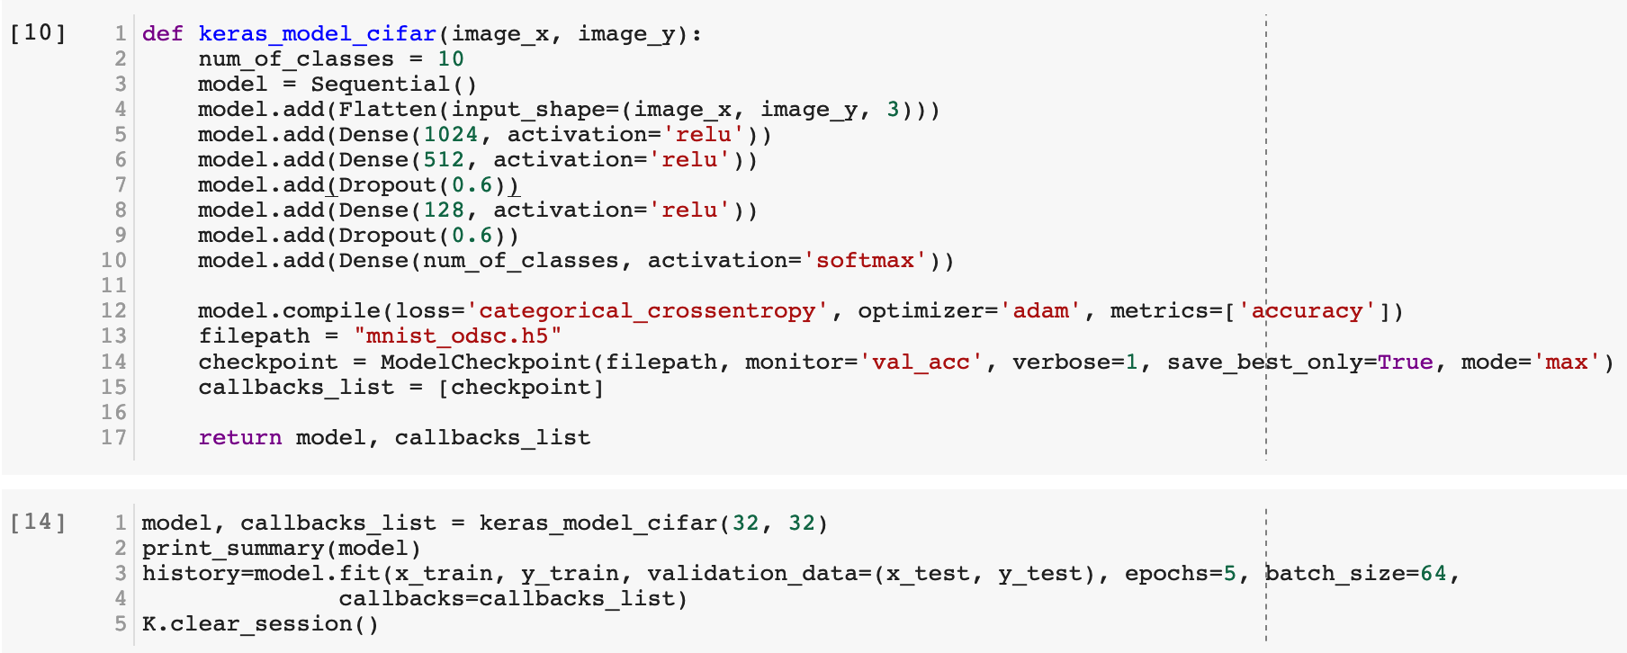
FC Architecture
Notes:
RMSprop

Slide 29
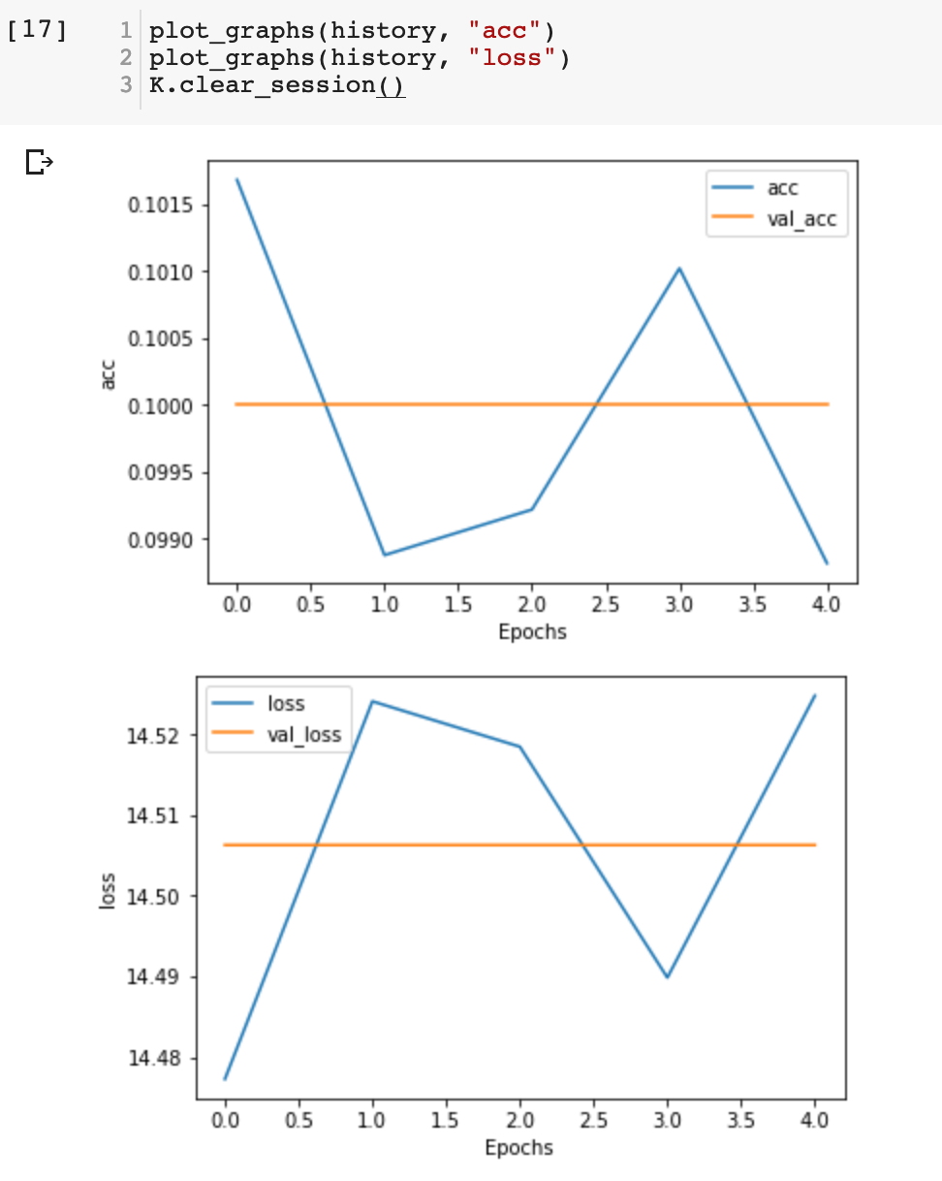
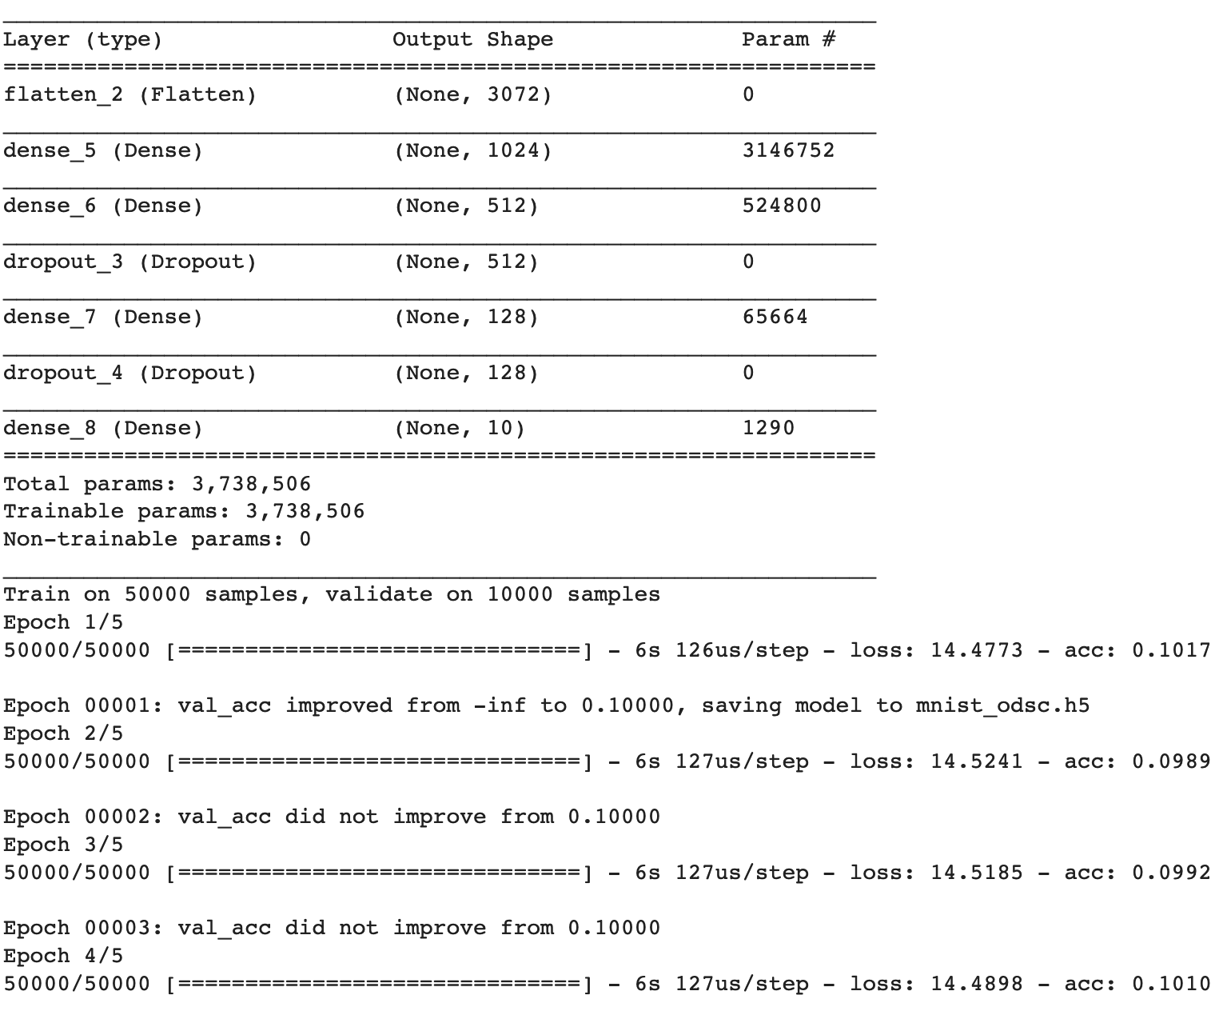

Slide 30
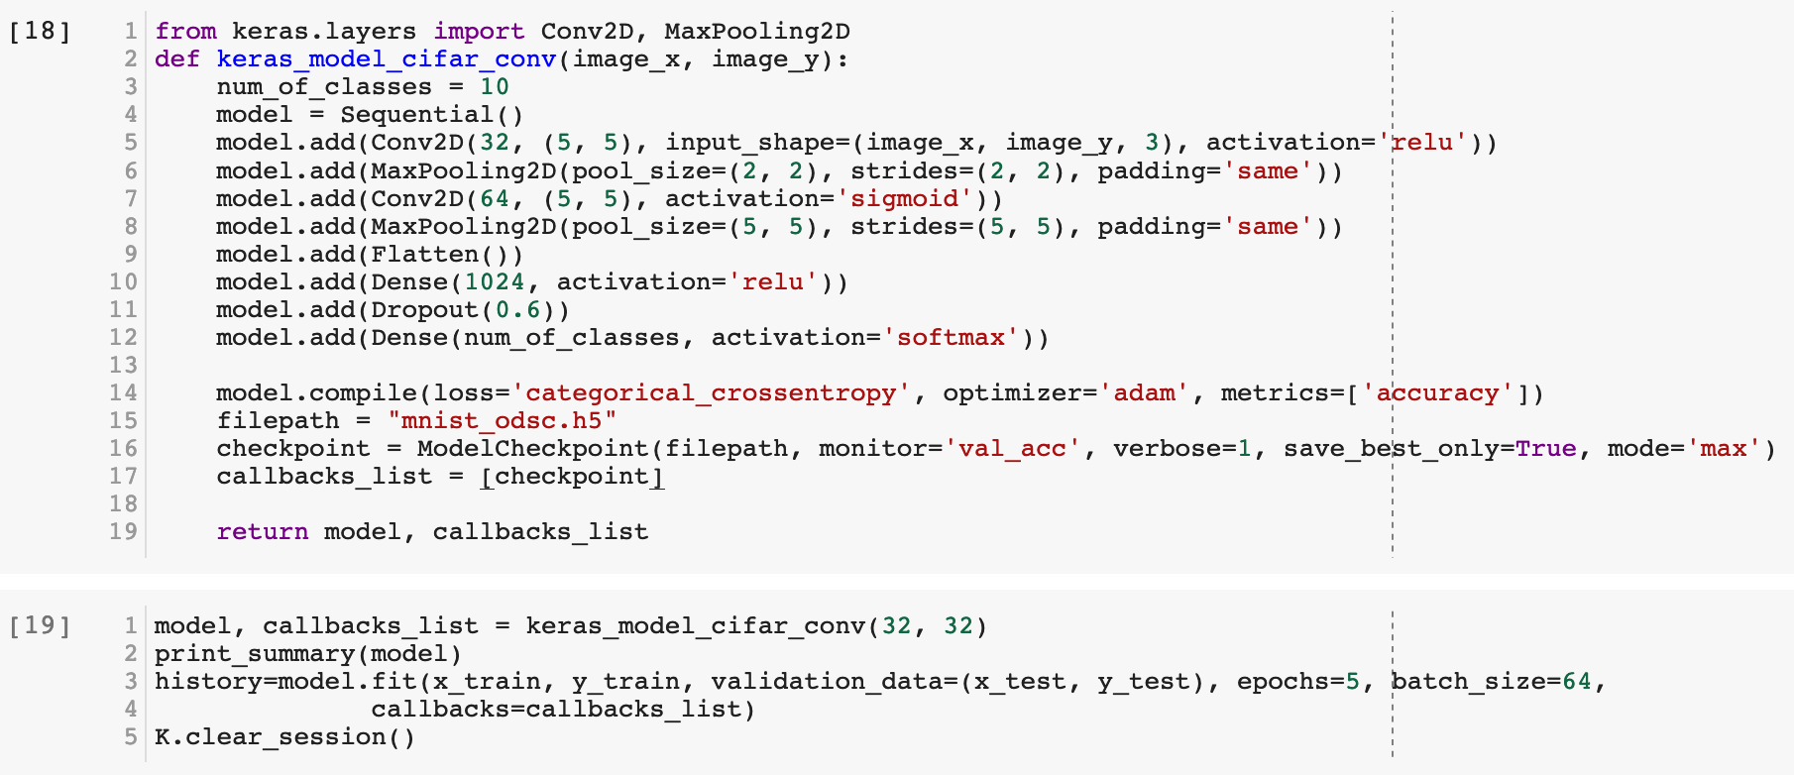
CNN Architecture
Notes:
RMSprop

Slide 31
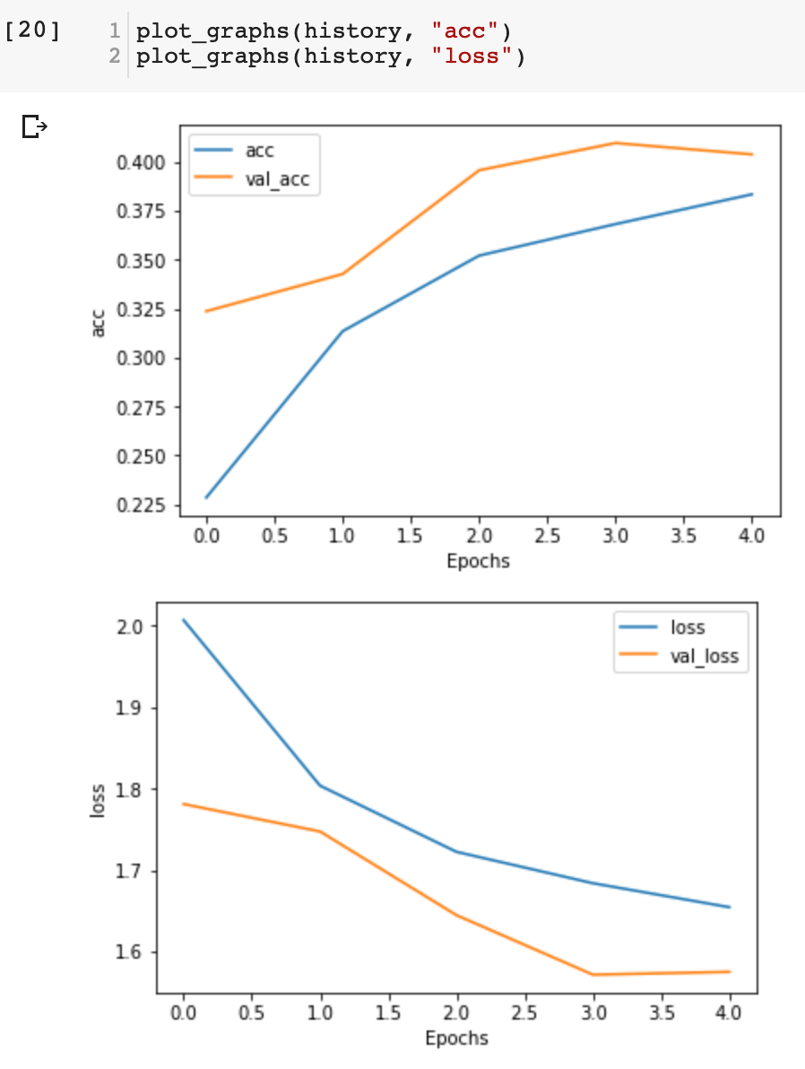
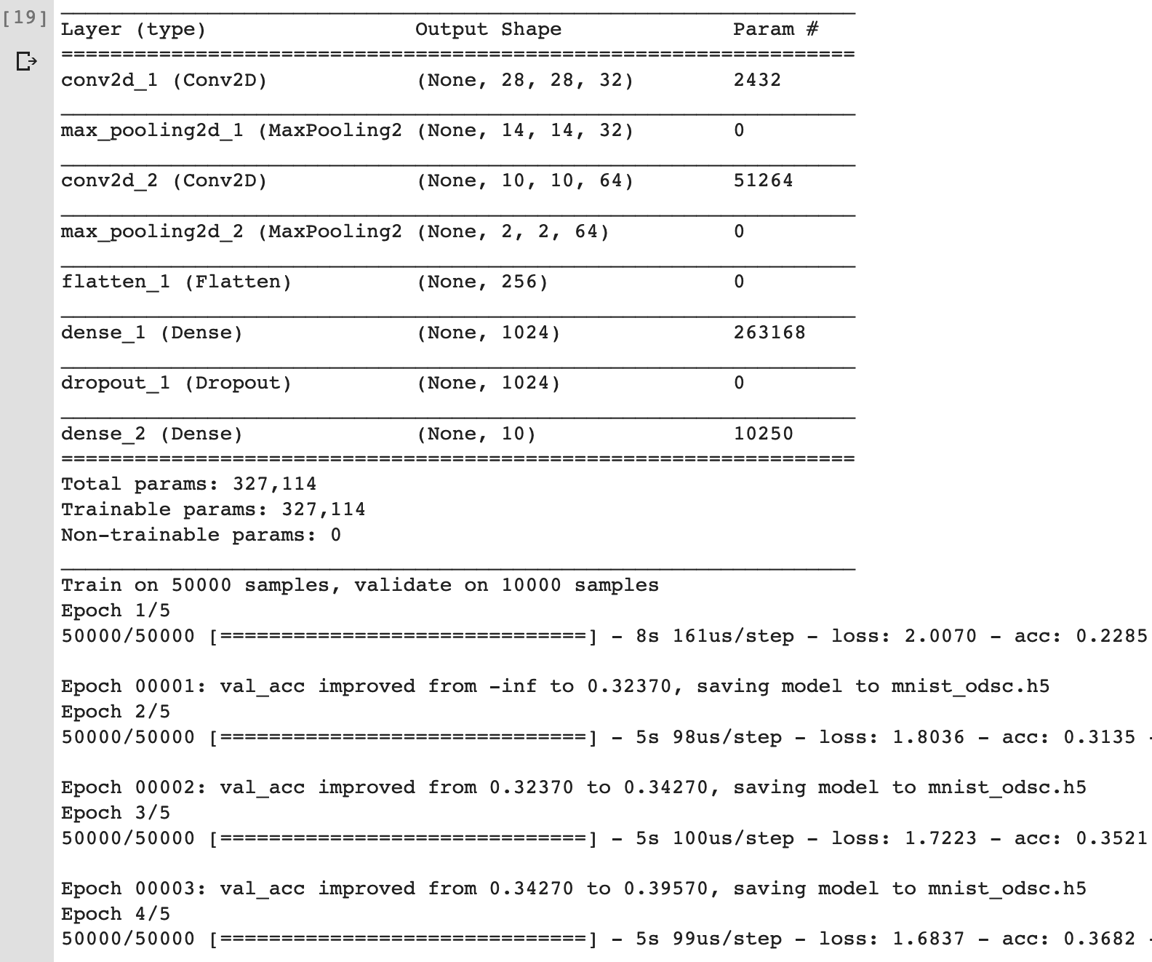

Slide 32
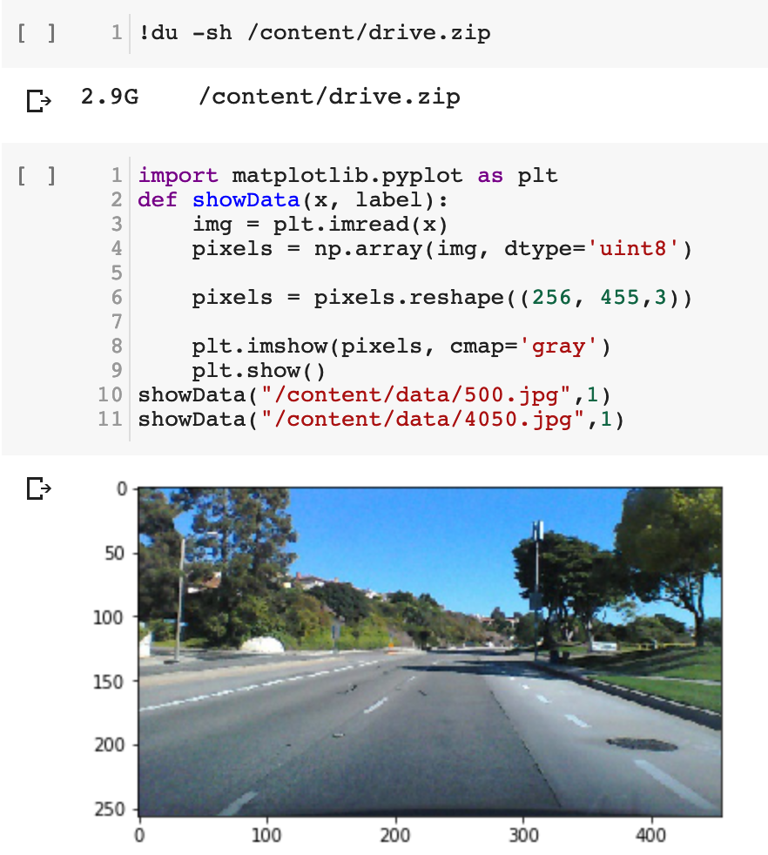
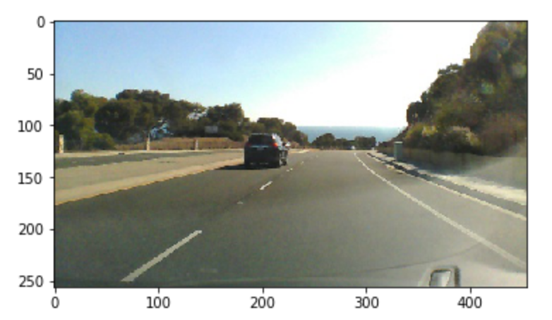
Autopilot research paper by NVIDIA

Slide 33
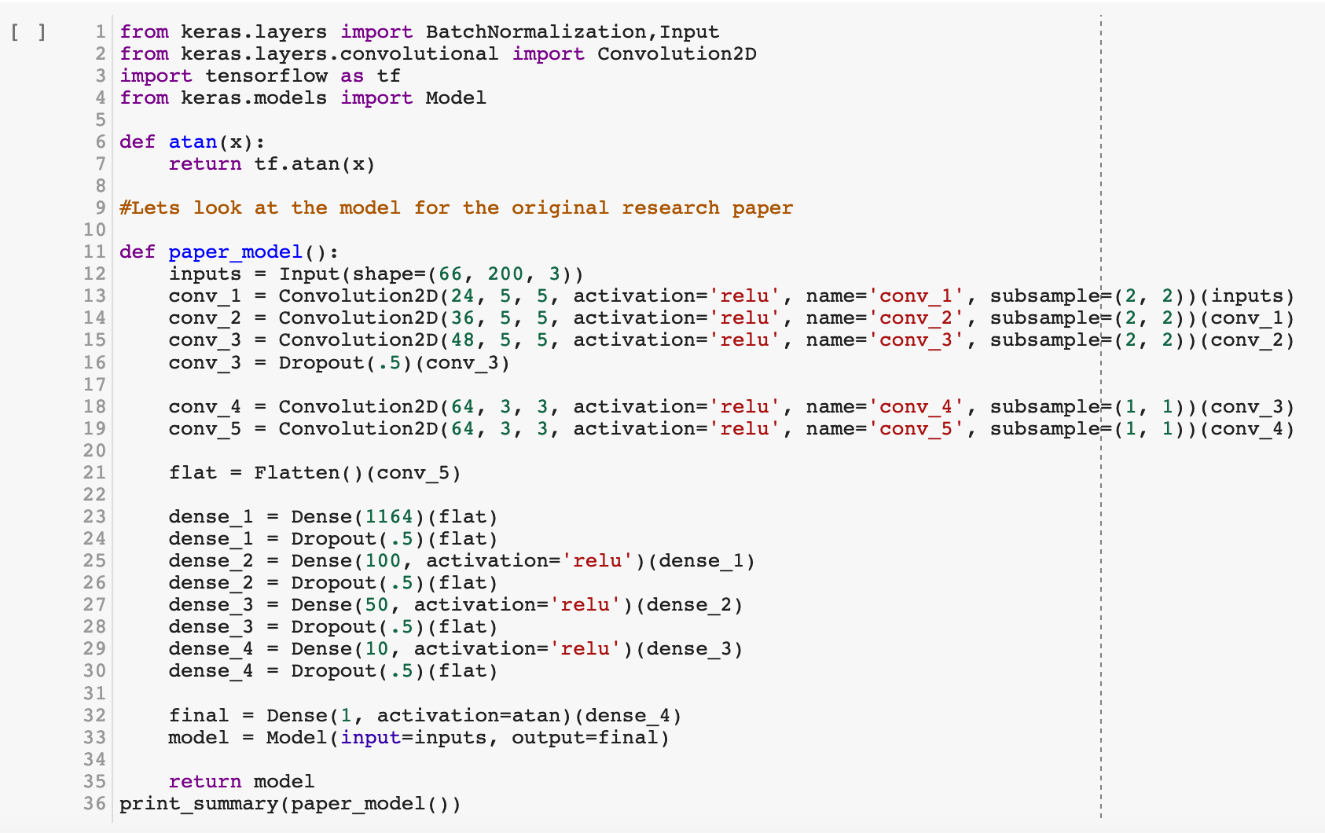

Slide 34
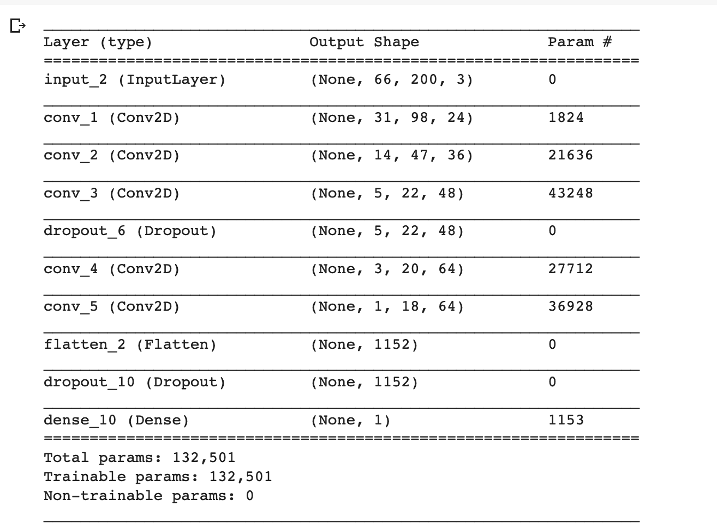
Total pixels per image = 66*200*3
= 39,600

Slide 35
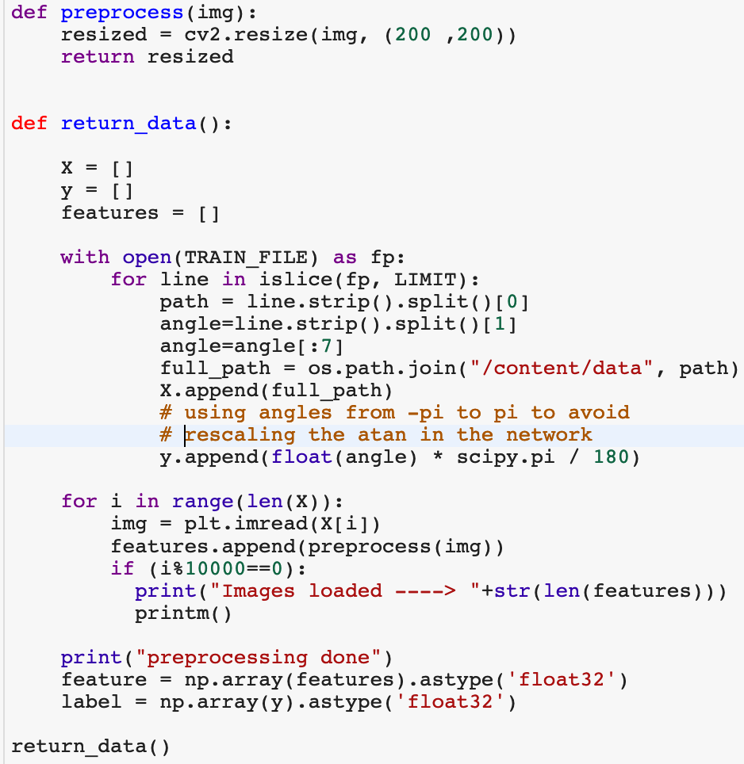
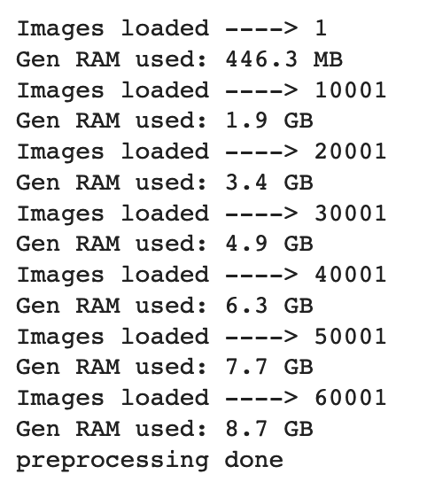

Slide 36
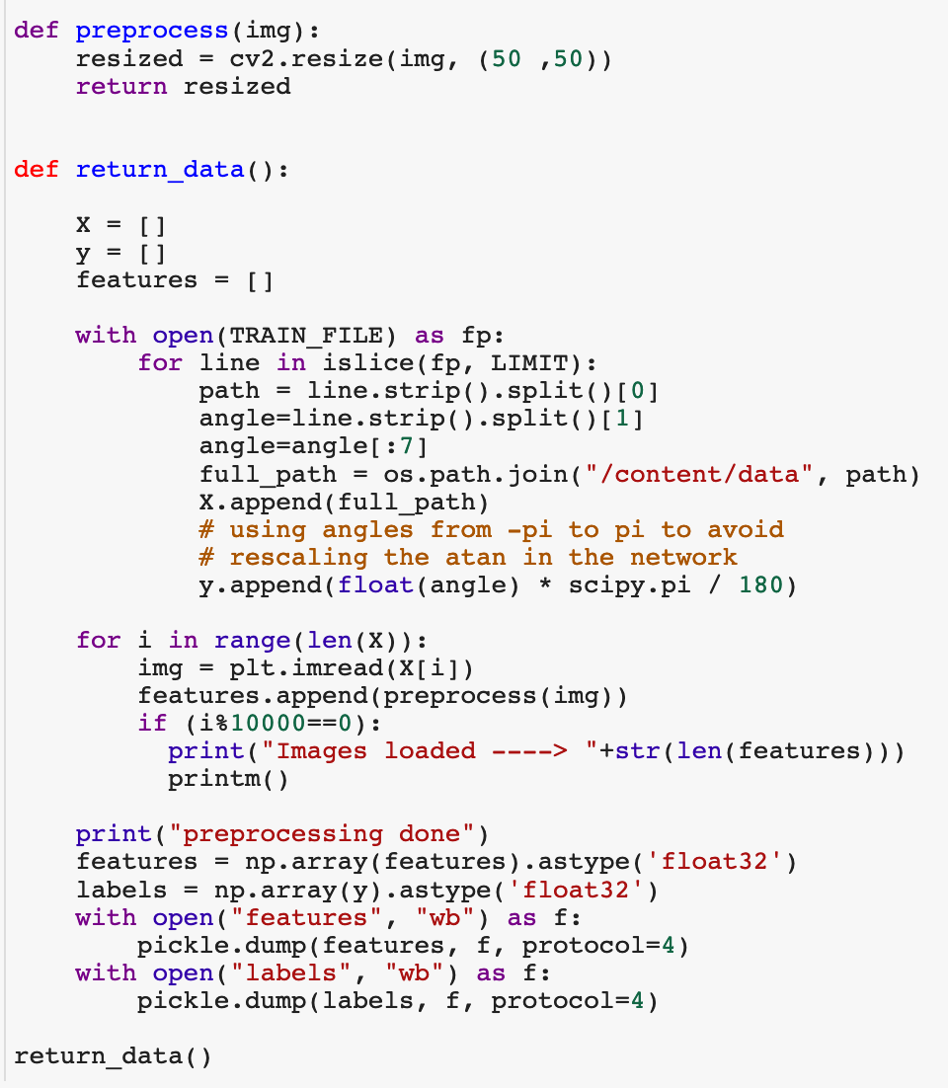
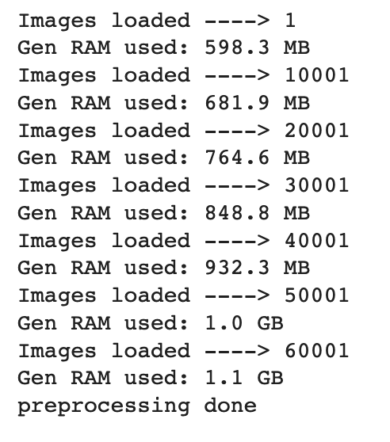
Handling out of memory issue
Scaling
Notes:
RMSprop

Slide 37
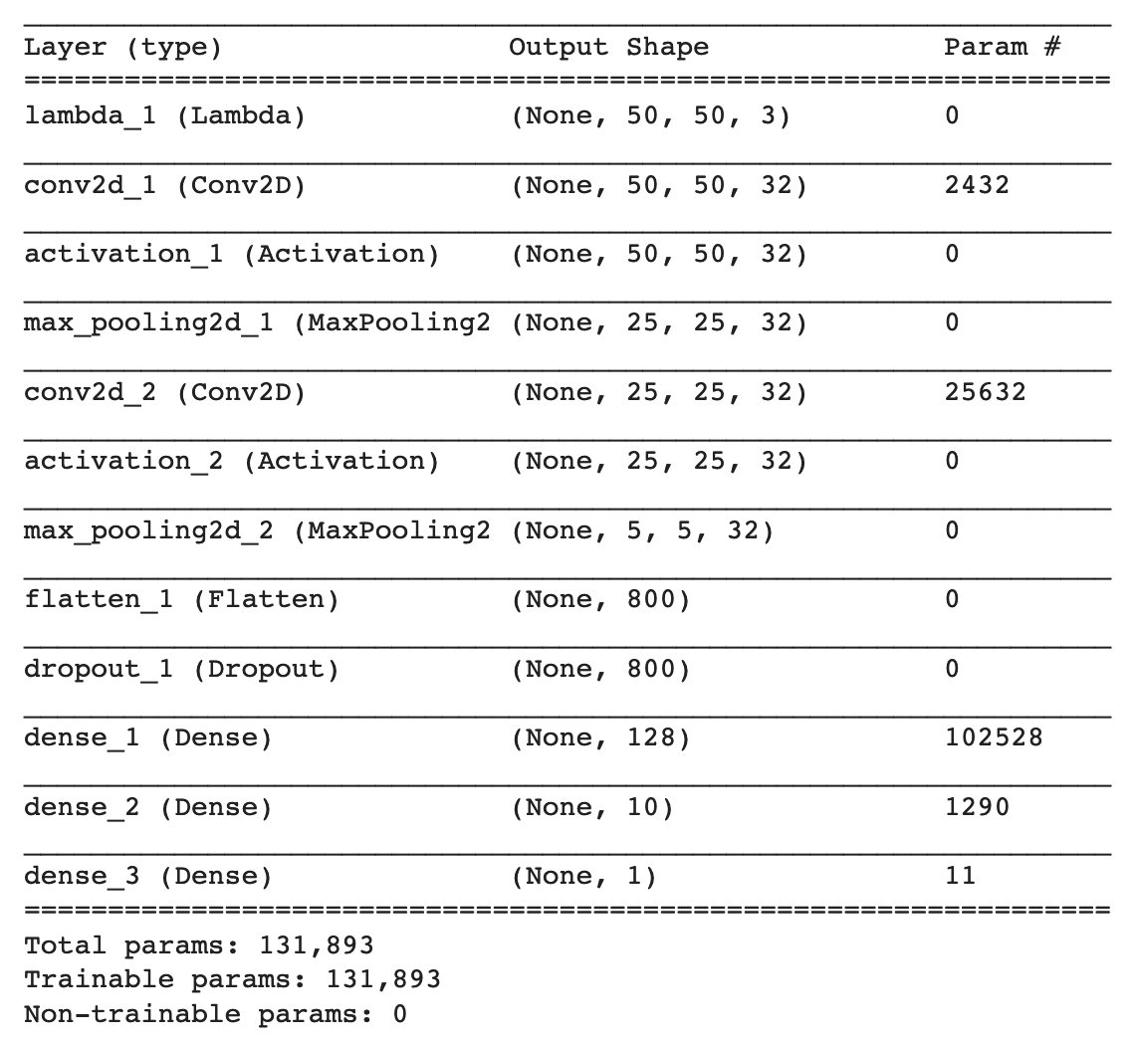
Total pixels per image = 50*50*3
= 7500

Slide 38
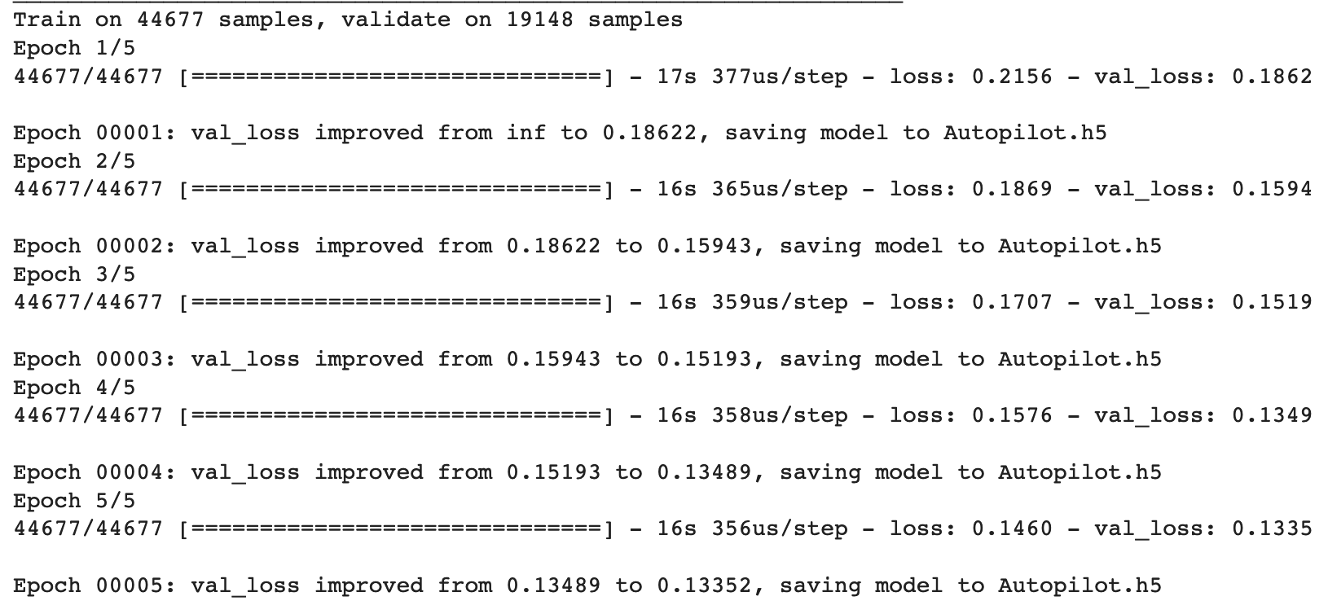
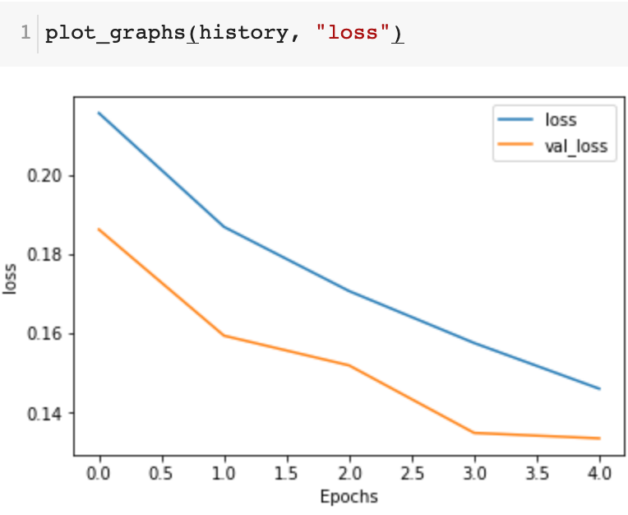

Slide 39
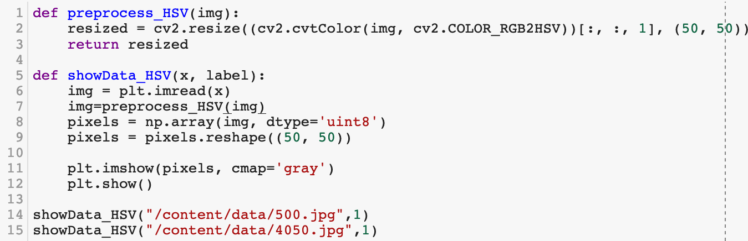
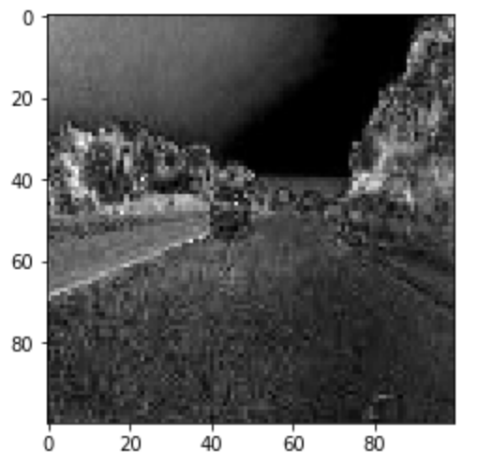
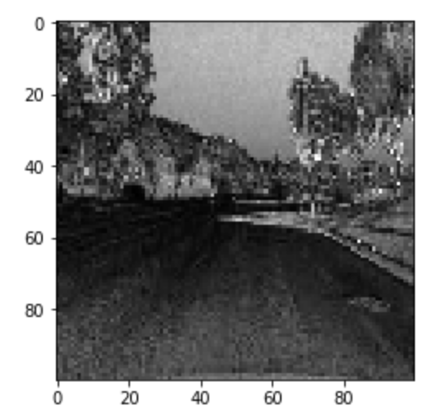
Filtering
Notes:
RMSprop

Slide 40
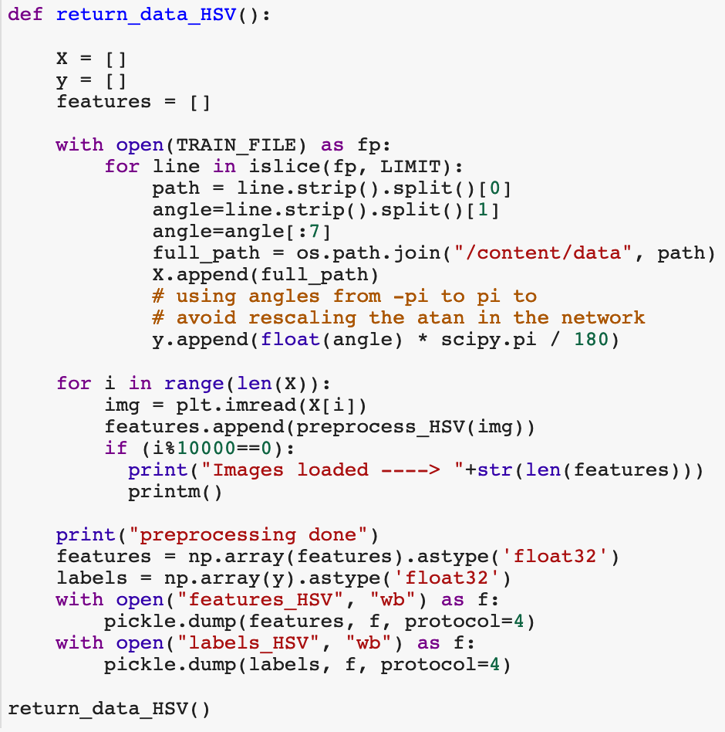
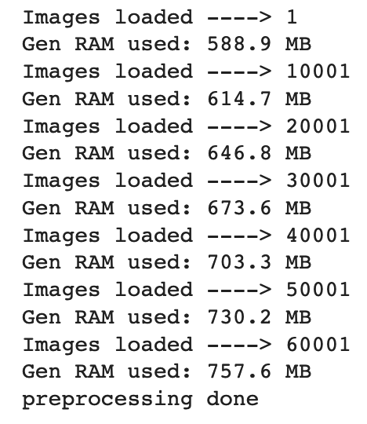

Slide 41

Total pixels per image = 50*50
= 2500

Slide 42



Slide 43

Using fit_generator
Notes:
RMSprop

Slide 44


Total pixels per image = 200*200*3
= 120,000

Slide 45



Slide 46
Autopilot V2

Slide 47



Emojinator
Image generator for Data Augmentation

Slide 48




Slide 49










Slide 50




Slide 51
Emojinator

Slide 52
Rock – Paper- Scissors

Slide 53





Malaria Detection

Slide 54



Filtering
Notes:
RMSprop

Slide 55


Filtering
Notes:
RMSprop

Slide 56
DeepSign

Slide 57

Let’s address those problems – Q/A

Slide 58


